Slide 1
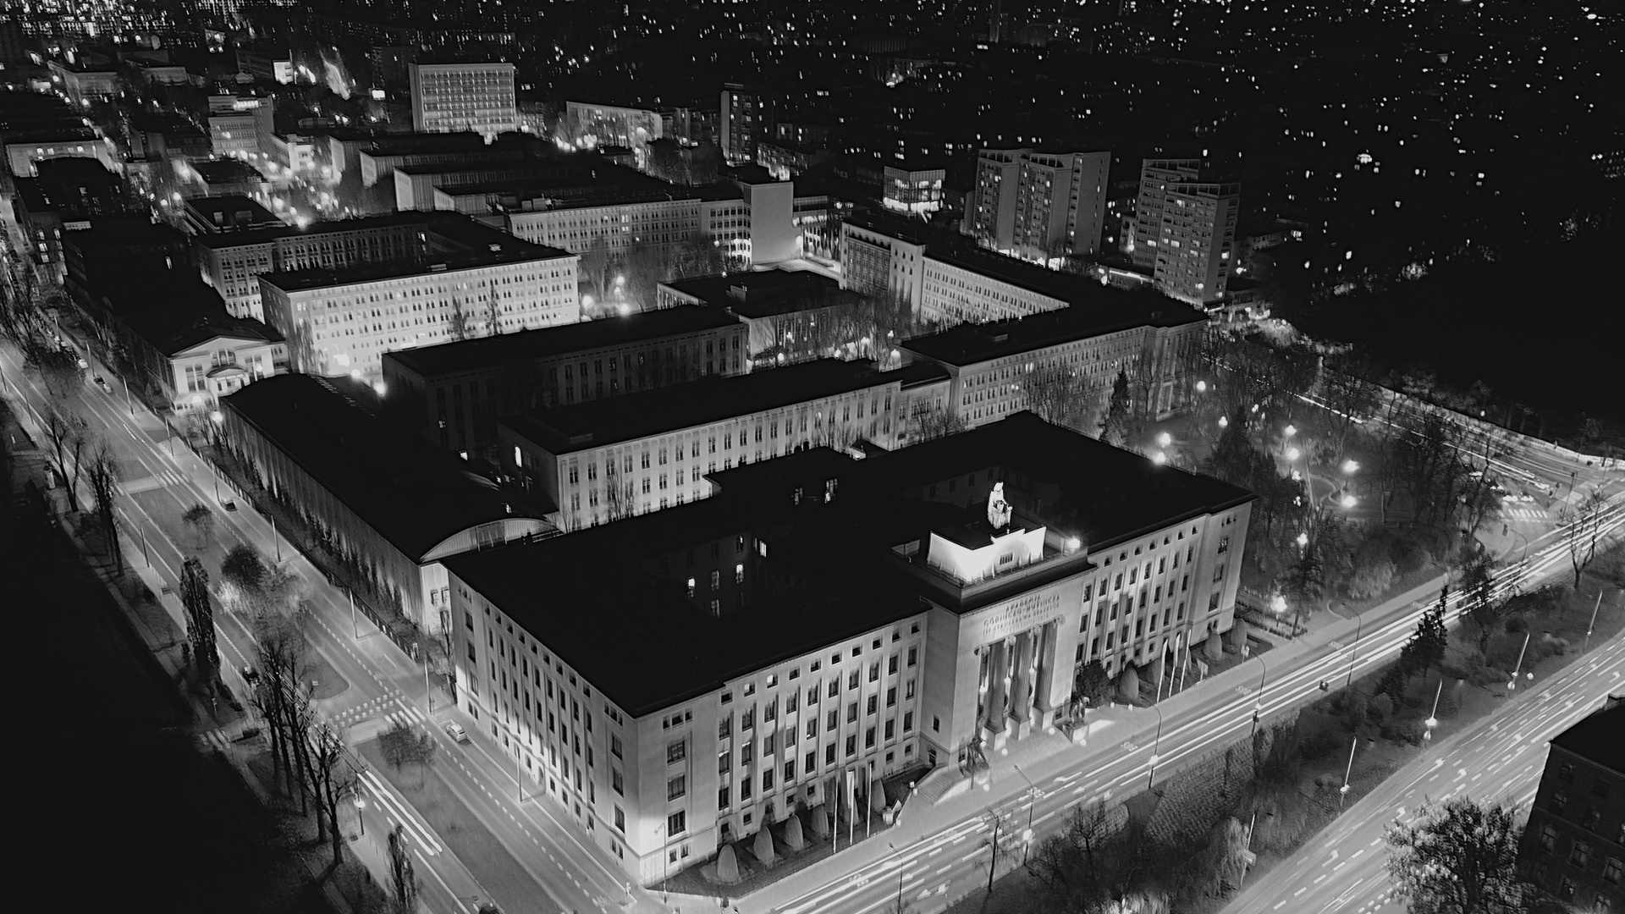
AGH
UNIVERSITY
OF KRAKOW
Notes:
Cracow is located in Central Europe

Slide 2
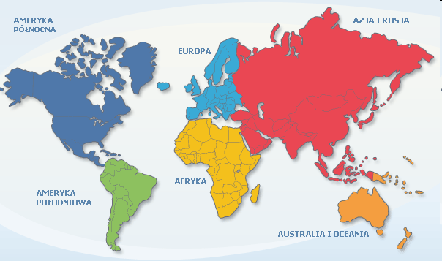
Europe – Poland – Malopolska – Krakow – AGH

Slide 3

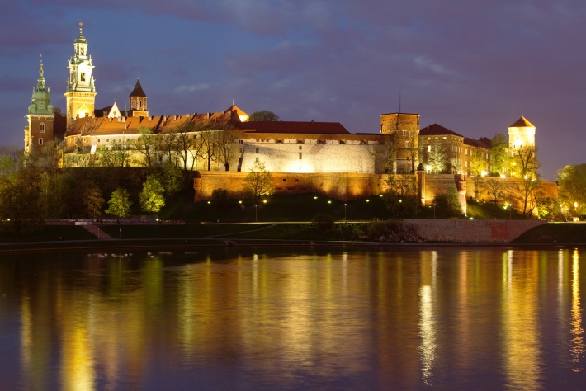
Krakow is the historical and cultural capital of Poland – it has about 1 million citizens
Theatres, galleries, museums – Krakow’s charm and magic are captivating
Krakow academic centre – 8 public and 12 private universities, JU established
in 1364
Krakow is the second largest business and industrial cantre in Poland
Unique atmosphere for more than 200,000 students
Krakow – a city of history,
science and culture
AGH UNIVERSITY OF THE FUTURE
Notes:
As I said, Krakow is the cultural, scientific and entertainment capital of Poland
We are the second academic center after Warsaw.

Slide 4
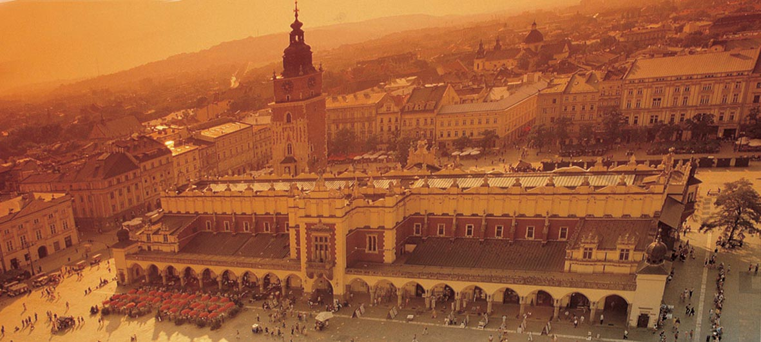
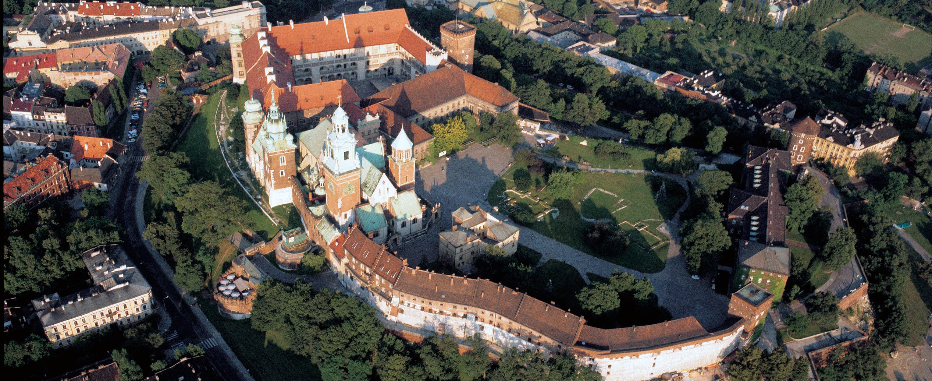
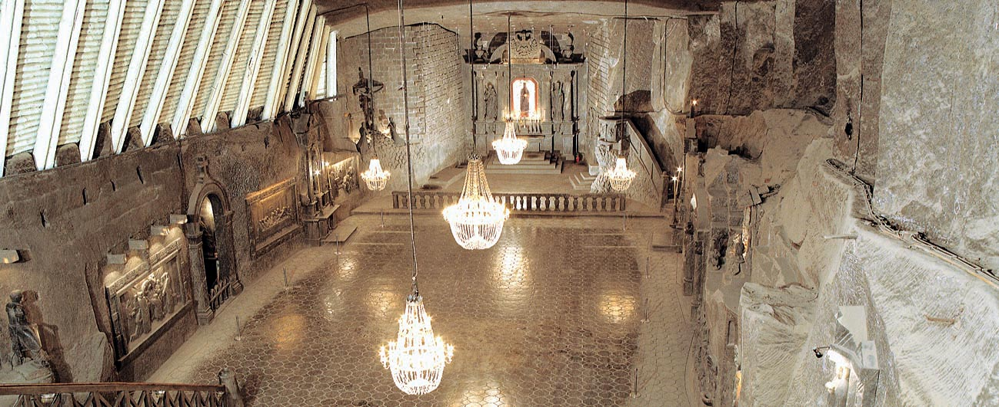
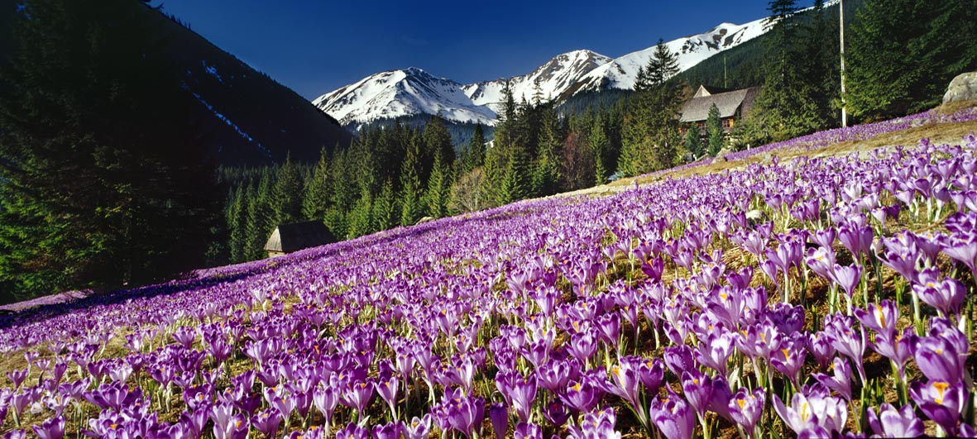
Mining and Geoengineering
Geology, Geophysics
Metals Engineering and
Applied Mathematics
Industrial Computer Science
Materials and Ceramics
Science
Physics and Applied
Computer Science
Non-Ferrous Metals
Electrical Engineering,
Automatics, Computer Science
and Medical Engineering
Drilling, Oil, Gas
Foundary Engineering
Management
Energy and Fuels
Mechanical Engineering and
Robotics
Electronics, Computer Science
and Telecommunication
POLAND Krakow region
Mining Surveying and
Environmental Egineering
Centre of Nanotechnooogy
and New Materials
KRAKOW
almost 6,000 historical monuments and 15.5 million visitors in 2019
Humanistic Sciences

Slide 5

AGH
University
Of Krakow

Slide 6

100 Years of the AGH University
The university that serves the economy and the society
Establishment of the university – 31 May 1913
Emperor Francis Joseph I approved the establishment of a higher school of mining in Krakow
Opening of the university – 20 October 1919
Józef Piłsudski, the Chief of State, opened the Mining Academy
In 2015, a resolution was made to rename the academy as ”AGH University of Science and Technology”.
AGH UNIVERISTY OF THE FUTURE
Notes:
Our university has over 100 years of tradition. It was founded in 1913 by Emperor Franz Joseph. Marshal Piłsudski began his first year of education after the First World War in 1919.

Slide 7
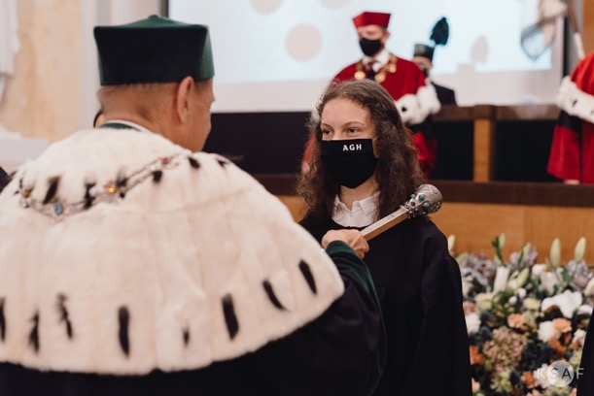
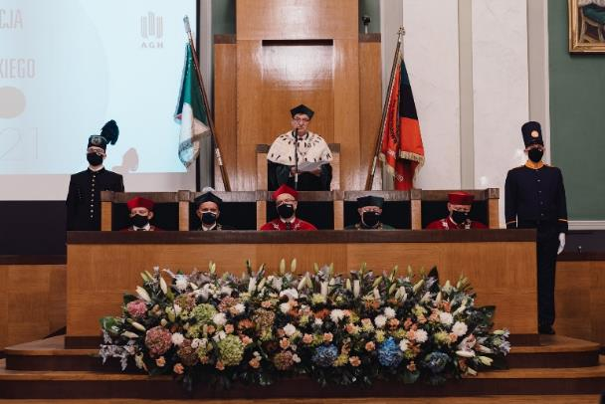

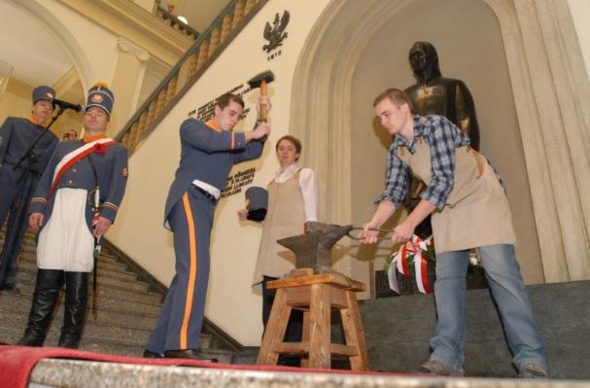
AGH UNIVERSITY CEREMONIES
Official inauguration of the academic year
Mining ceremonies (Miner’s Day)
Metallurgy ceremonies (Metallurgist’s Day)
Notes:
For the past 100 years, we have cultivated traditions at our university. Every year in May, there is a metalurgist's day, and in December, a miner's day. For several years we have also had a science day listening (Hoborski days)

Slide 8
AGH UNIVERSITY
IN NUMBERS
17 Faculties + the Academic Centre for Materials and Nanotechnology
81 programmes of study
More than 200 diploma specialisations
Total number of students (2023): over 18,000
  full-time students: 15,962
  part-time students: 2,112
  doctoral students: 813
  postgraduate students: 1930
  foreign students: 1,000
Over 250,000 alumni sent to the economic sector
2,500 academic staff, 6,000 employees

Slide 9

STRUCTURE
FACULTIES
Faculty of Civil Engineering and Resource Management
Faculty of Metals Engineering and Industrial Computer Science
Faculty of Electrical Engineering, Automatics, Computer Science, and Biomedical Engineering
Faculty of Computer Science, Electronics, and Telecommunications
Faculty of Mechanical Engineering and Robotics
Faculty of Geology, Geophysics, and Environmental Protection
Faculty of Geo-Data Science, Geodesy, and Environmental Engineering
Faculty of Materials Science and Ceramics
Faculty of Foundry Engineering
Faculty of Non-Ferrous Metals
Faculty of Drilling, Oil, and Gas
Faculty of Management
Faculty of Energy and Fuels
Faculty of Physics and Applied Computer Science
Faculty of Applied Mathematics
Faculty of Humanities
Faculty of Computer Science
AGH University Doctoral School
Department of Foreign Languages
Department of Sport and Physical Education

Slide 10


From the early days of the AGH University, its fundamental mission has been to cooperate with the economy
"Labore creata,
labori et scientiae servio”
Created by labour,
I serve labour and knowledge
AGH UNIVERSITY OF THE FUTURE

Slide 11




AGH University adapts its education and research profiles to the requirements of the labour market
AGH UNIVERSITY OF THE FUTURE

Slide 12

Priorities of the global and Polish market and economy:
Computer science and telecommunications – “Digitalisation: IT, CS, AI, …”
Power Engineering – “Energy transformation and zero emission”
Geoscience – “Climate protection”
Cutting-edge technologies – “Circular economy”
Mechanics, automatics, and robotics –“Industry 4.0”
Materials & technologies – “Zero waste”
….
AGH University educates specialists for the market – our social mission
AGH UNIVERSITY OF THE FUTURE

Slide 13

HIGH-QUALITY AND MODERN EDUCATION
  AGH UNIVERSITY offers:
  first-cycle programmes of study
  students obtain a Bachelor of Science
  or Bachelor of Arts degree
  second-cycle programmes of study
  students obtain a Master of Arts
  or Master of Science degree
  doctoral studies ”AGH University
  Doctoral School”
  postgraduate studies
AGH UNIVERSITY OF THE FUTURE

Slide 14
Online / e-learning studies
Studies in English
AGH Open University
Year Zero courses
Preparatory courses
Remedial courses
Summer schools for foreigners
Courses and trainings
AGH Junior Academy
……….
FLEXIBLE FORMS OF EDUCATION
AGH UNIVERSITY OF THE FUTURE

Slide 15
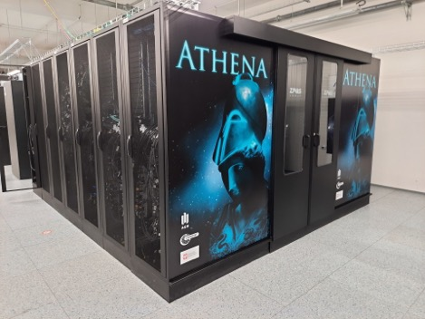

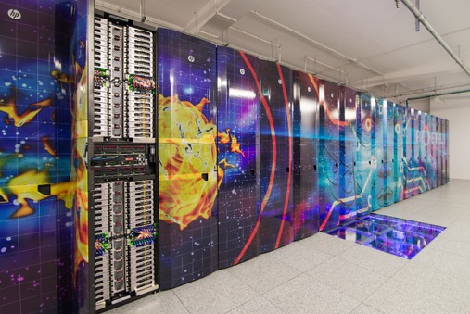
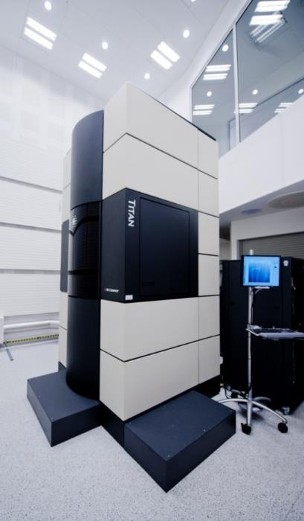
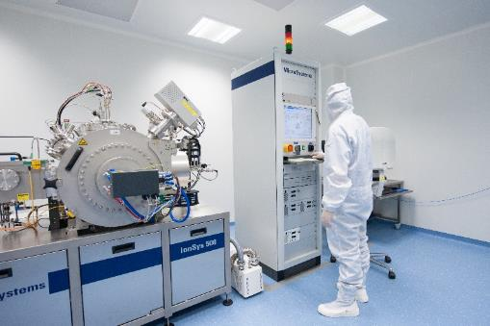
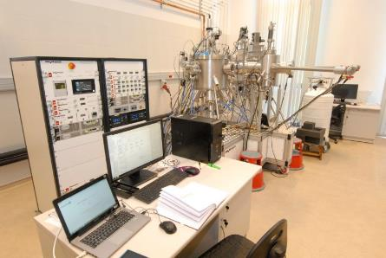
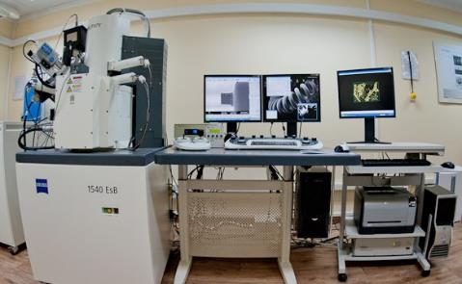
Unique and modern world-class equipment

Slide 16

  NEW RESEARCH CENTRES:
  New Materials and Technologies
  Space Technology
  Cybersecurity
  Artificial Intelligence
  ……
SPACE UNIVERSITY
UNIVERSEH – European Space University for Earth and Humanity: Universities of Toulouse, Luxemburg, Lulea, Dusseldorf, and AGH University
AGH University Space Technology Centre
Space engineering related education programmes
Space inspires research & transfer of technology
Achievements of “AGH Space Systems” student research club
Network of 17 Polish Space Universities
AGH UNIVERSITY OF THE FUTURE

Slide 17
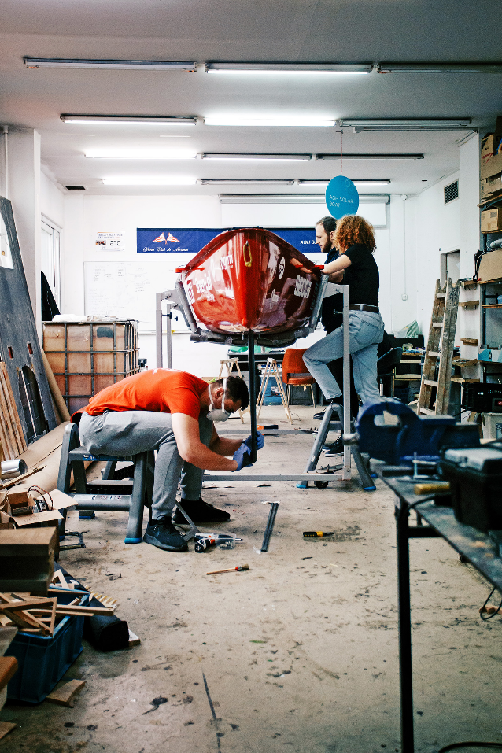
AGH University
technology transfer
AGH University Technology Transfer Centre
Krakow Centre for Innovative Technology INNOAGH
30 start-ups incubated at the AGH University
Partnership with Krakow Technology Park
and other innovative institutions
AGH UNIVERSITY OF THE FUTURE

Slide 18
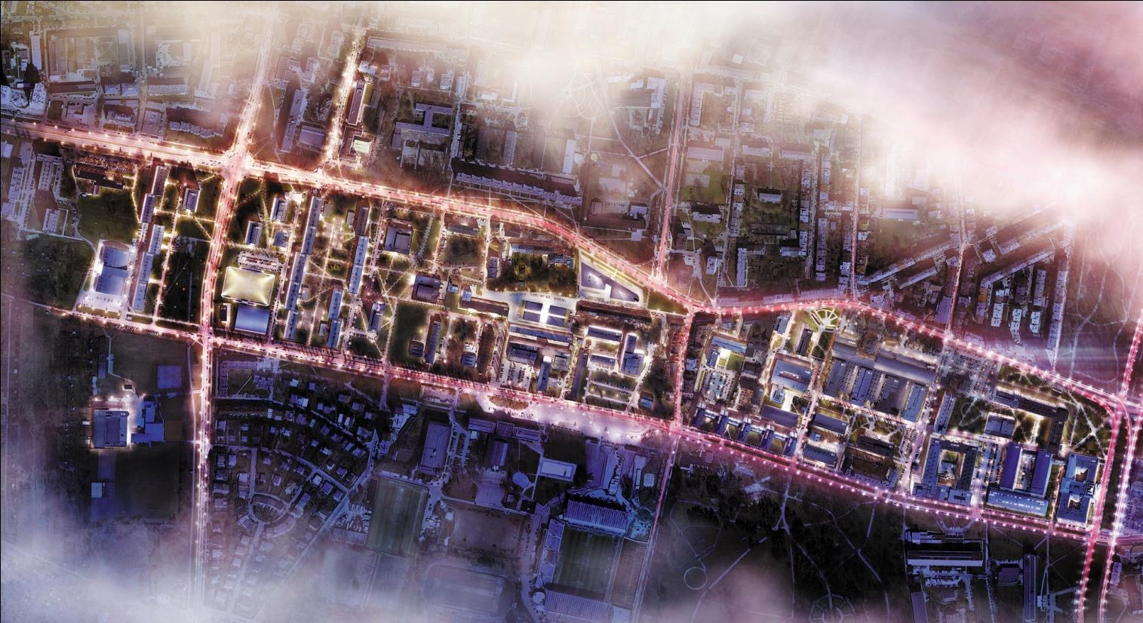
AGH UNIVERSITY
CAMPUS

Slide 19
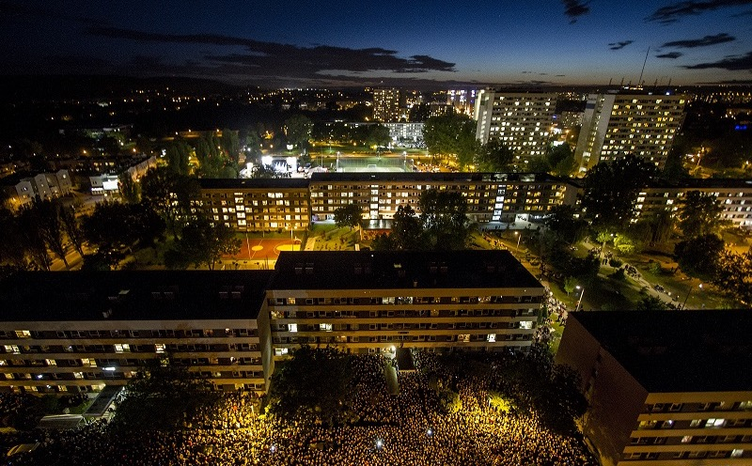
AGH UNIVERSITY STUDENT CAMPUS
The largest student campus in Poland!
more than 10,000 students
Campus facilities:
halls of residence
student clubs
Klub STUDIO
academic radio
bank
sports hall
swimming pool
football field and tennis courts
shops, supermarkets
catering outlets
nursery school

Slide 20
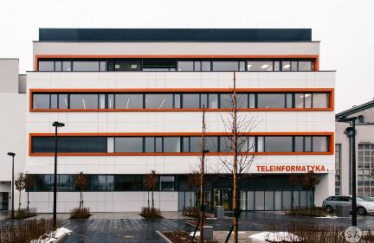
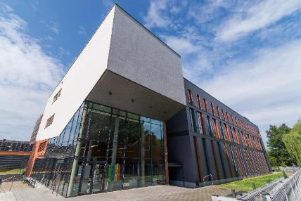
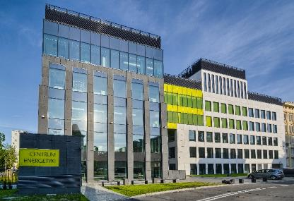
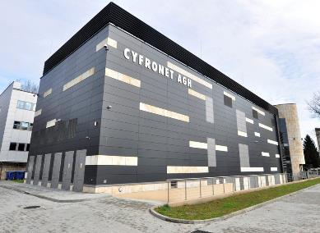
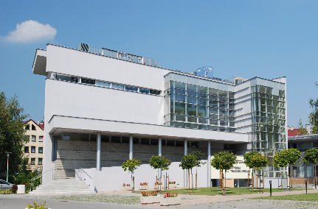
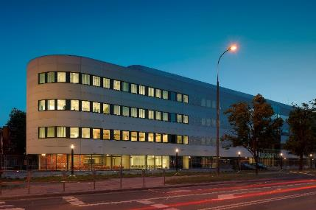
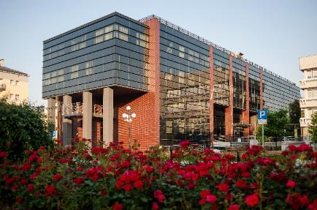
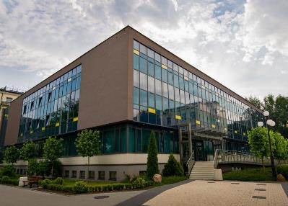
In the last 15 years, more than 20 large construction projects have been carried out.
AGH UNIVERSITY FACILITIES
Department of Telecommunications, II
Academic Centre for Materials
and Nanotechnology
Centre of Energy
Academic Computer Centre CYFRONET
Department of Telecommunications, I
Centre of Computer Science
Centre of Ceramics
Main Library

Slide 21
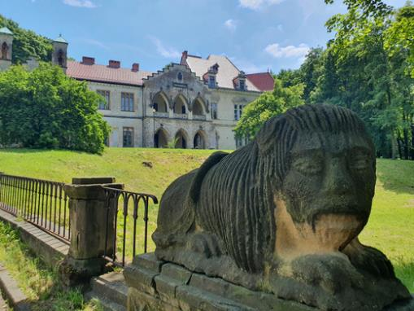
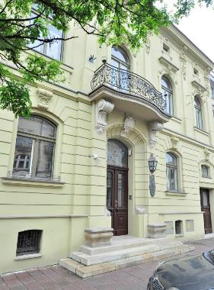
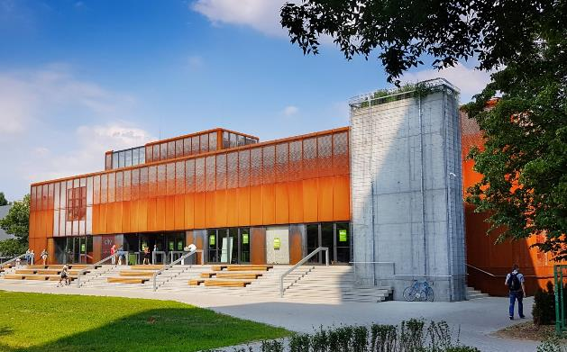
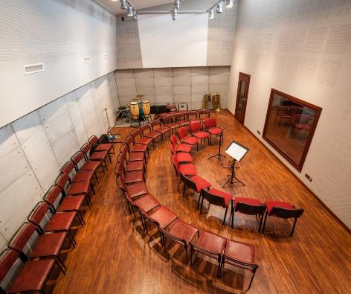
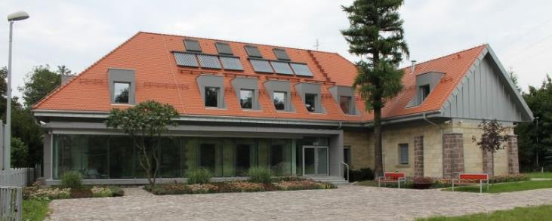
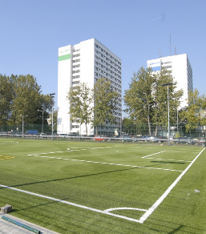
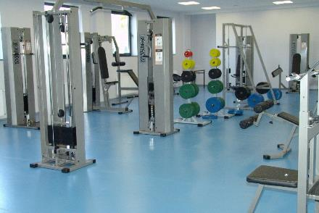
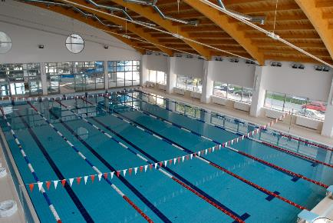
INFRASTRUCTURE
Park and palace complex in Młoszowa
Sienkiewiczówka –guest house
Klub STUDIO
Music Production Studio „Kotłownia”
Centre of New Energies in Miękinia
Student Campus
Fitness Centre
Swimming pool

Slide 22
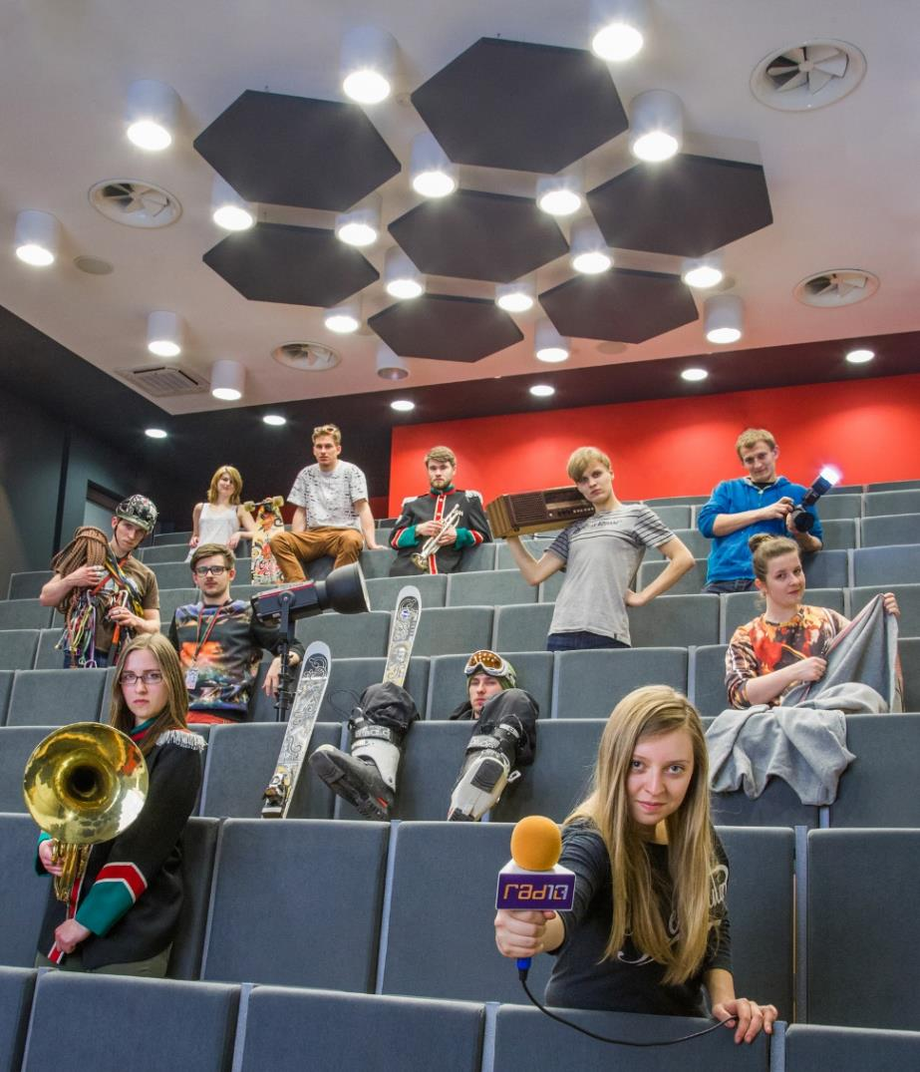
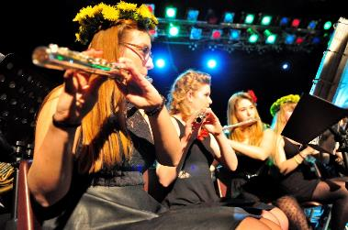

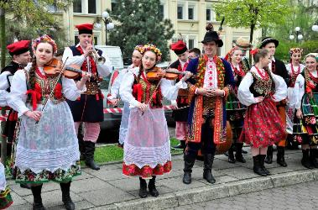
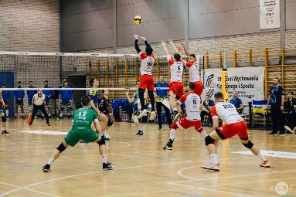
STUDENT LIFE
A unique place to study ☺
AGH UNIVERSITY OF THE FUTURE

Slide 23

AGH University

